Slide 1
Capstone Project Battle of Neighborhoods Opening a Restaurant in Karnataka
By Hemika BS

Slide 2
Business Problem
Karnataka is a state in India. It is mainly centered in South India. It is known for its cultural, industrial, and financial centre. Bangalore is the capital of Karnataka and is a IT hub. Karnataka is located in the south of the country, at coordinates 15.3173° N, 75.7139° E.
Karnataka is the is the center of economy and industry. Karnataka has 6 crore populations and consists of 32 neighborhoods(districts). 5 of them are shown below:[1]
The main aim of this project is to open a restaurant in a suitable and populated neighborhood in Karnataka which offers various various cusines especially karnatic cusine. The districts are ranked based on their population and variety of cultures.

Slide 3
Data Sources
To consider the problem we can list the data below:
I get the neighborhood data of Karnataka from Wikipedia
I use python geocoder library to get geographical coordinates of neighborhoods(districts)
I use Foursquare API venues explore method to get the venues of given neighborhoods of Karnataka
I use Foursquare API venues method to get ranks and likes of restaurants by given venue id

Slide 4
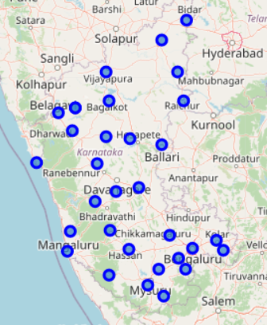
Methodology
I took neighborhood from wikipedia and put blue dots on Karnataka map to see centers of neighborhoods. There are 40 neighborhoods in Bucharest

Slide 5
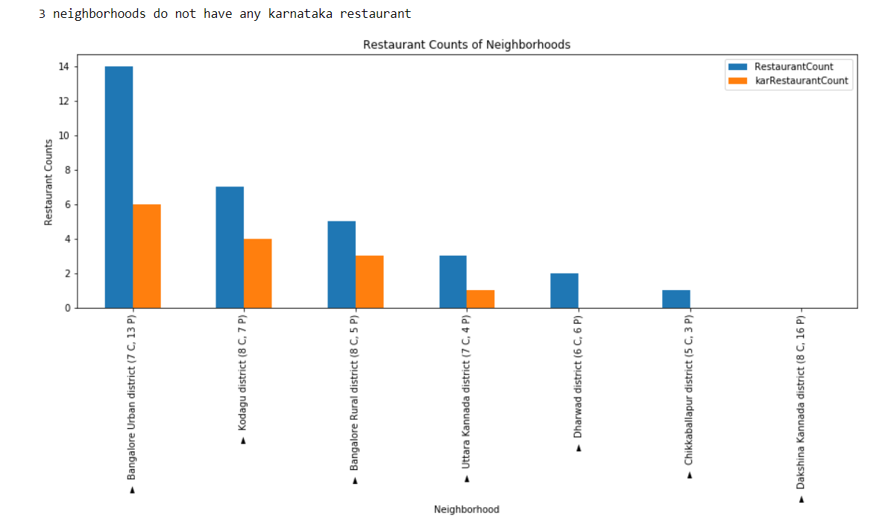
Methodology
By using Foursquare API I got venues 1 km around center of each neighborhood with limit 38 venue categories. I merged data with Neighborhood data.
I filtered All restaurants and Karnataka restaurant. We can see from histogram of restaurants, 3 neighborhoods has not any karnataka restaurant

Slide 6
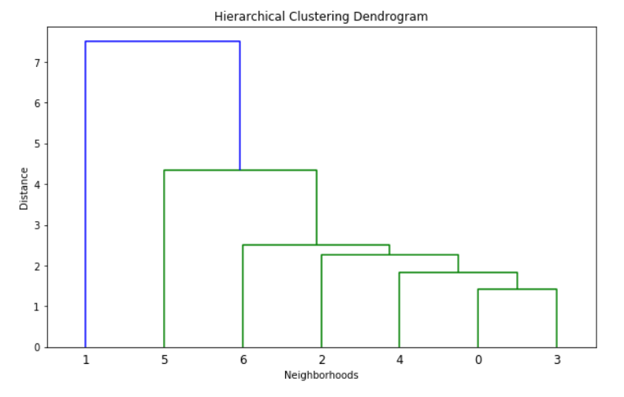
Methodology - Clustering
I used Agglomerative Clustering to cluster neighborhoods according to count of venue categories in each neighborhood. According to the below graph, I decided to separate our neighborhoods into 6 clusters (cut at distance of 20, horizontal black line).

Slide 7
Results
I investigated that the Indian restaurants in Karnataka counts is 43.75
Total number of restaurants: 32
Total number of Turkish restaurants: 14
From bar chart, we can see:
Bangalore Urban district is the neihgborhood having most restaurants
Dharwad has restaurants , but no karnataka style restaurant
dakshina kannada district has no restaurants.
3 neihgborhoods do not have any karnataka restaurant.

Slide 8
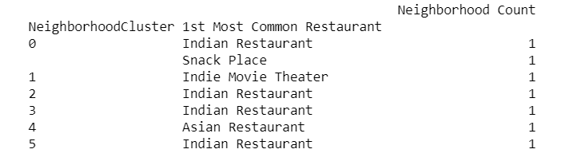
Discussions
Agglomerative clustering gives me 6 clusters
Cluster 0: Indian Restaurant, Fast food restaurant
Cluster 1 : Karnataka Restaurant
Cluster 2 : udupi Restaurant
Cluster 3 : café, Indian Restaurant
Cluster 4 : Asian restaurant
Cluster 5 : Indian Restaurant

Slide 9
Conclusion
I have chosen cluster 4 and cluster 5 as there is only one restaurant there and it would be more easy to open a restaurant as there is less competition which is managable.

